Slide 1
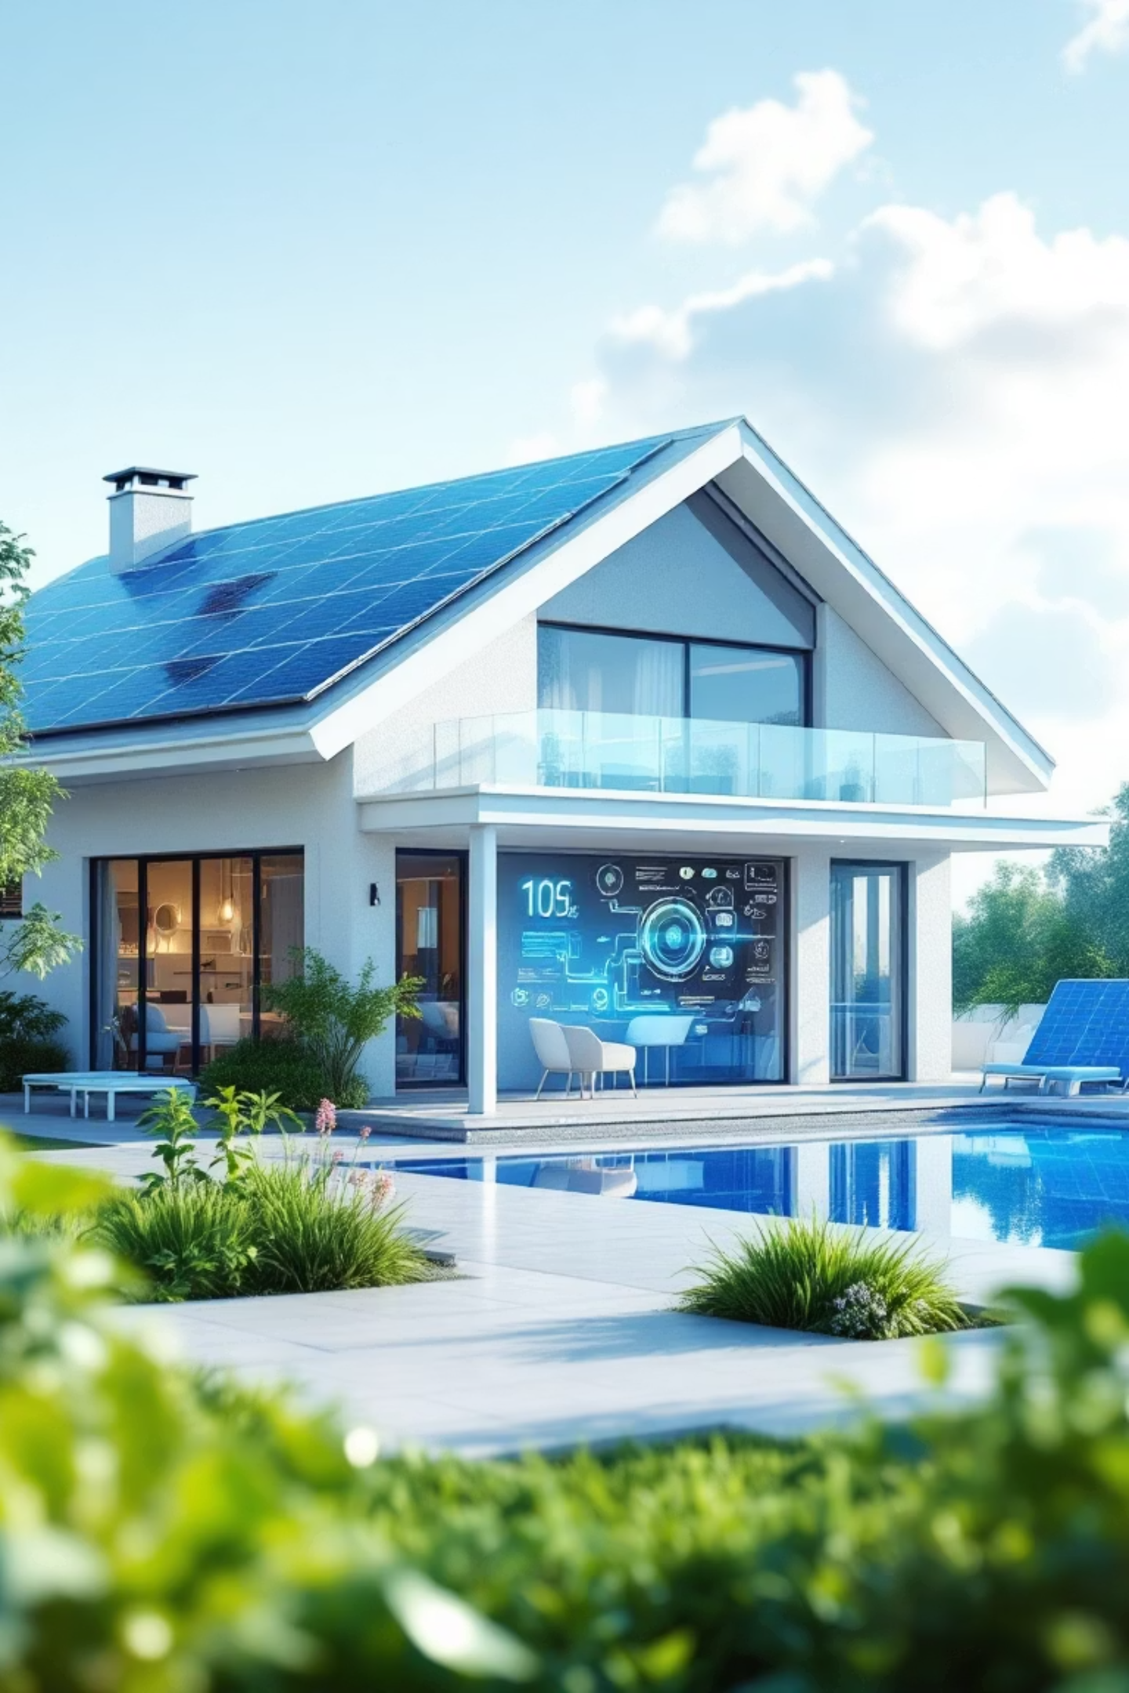

Analysis of Real-World Data from a Solar-Equipped Smart Home
A data-driven exploration of influence factors on solar energy generation and consumption patterns
Stephan Herbert
4.11.2025

Slide 2

Agenda
About me
Project context
Planning & Technology Stack
Data Sources & Energy Flow
Research Hypotheses
Hypotheses check
Summary and recommendations

Slide 3


About Me
Stephan Herbert
37 years old
Frankfurt am Main
Professional Background
Master degree in Mechanical engineering (TU Darmstadt)
7+ years of experience in the automotive industry (Continental / FRA)
Specialized in NVH / Acoustics
Analysis of production line data, using KNIME and Power BI
Career Goal
Transitioning into Data Analyst / BI Analyst roles to leverage analytical skills in data-driven decision making.
Looking for jobs in Frankfurt / Rhein-Main area
Link to LinkedIn

Slide 4
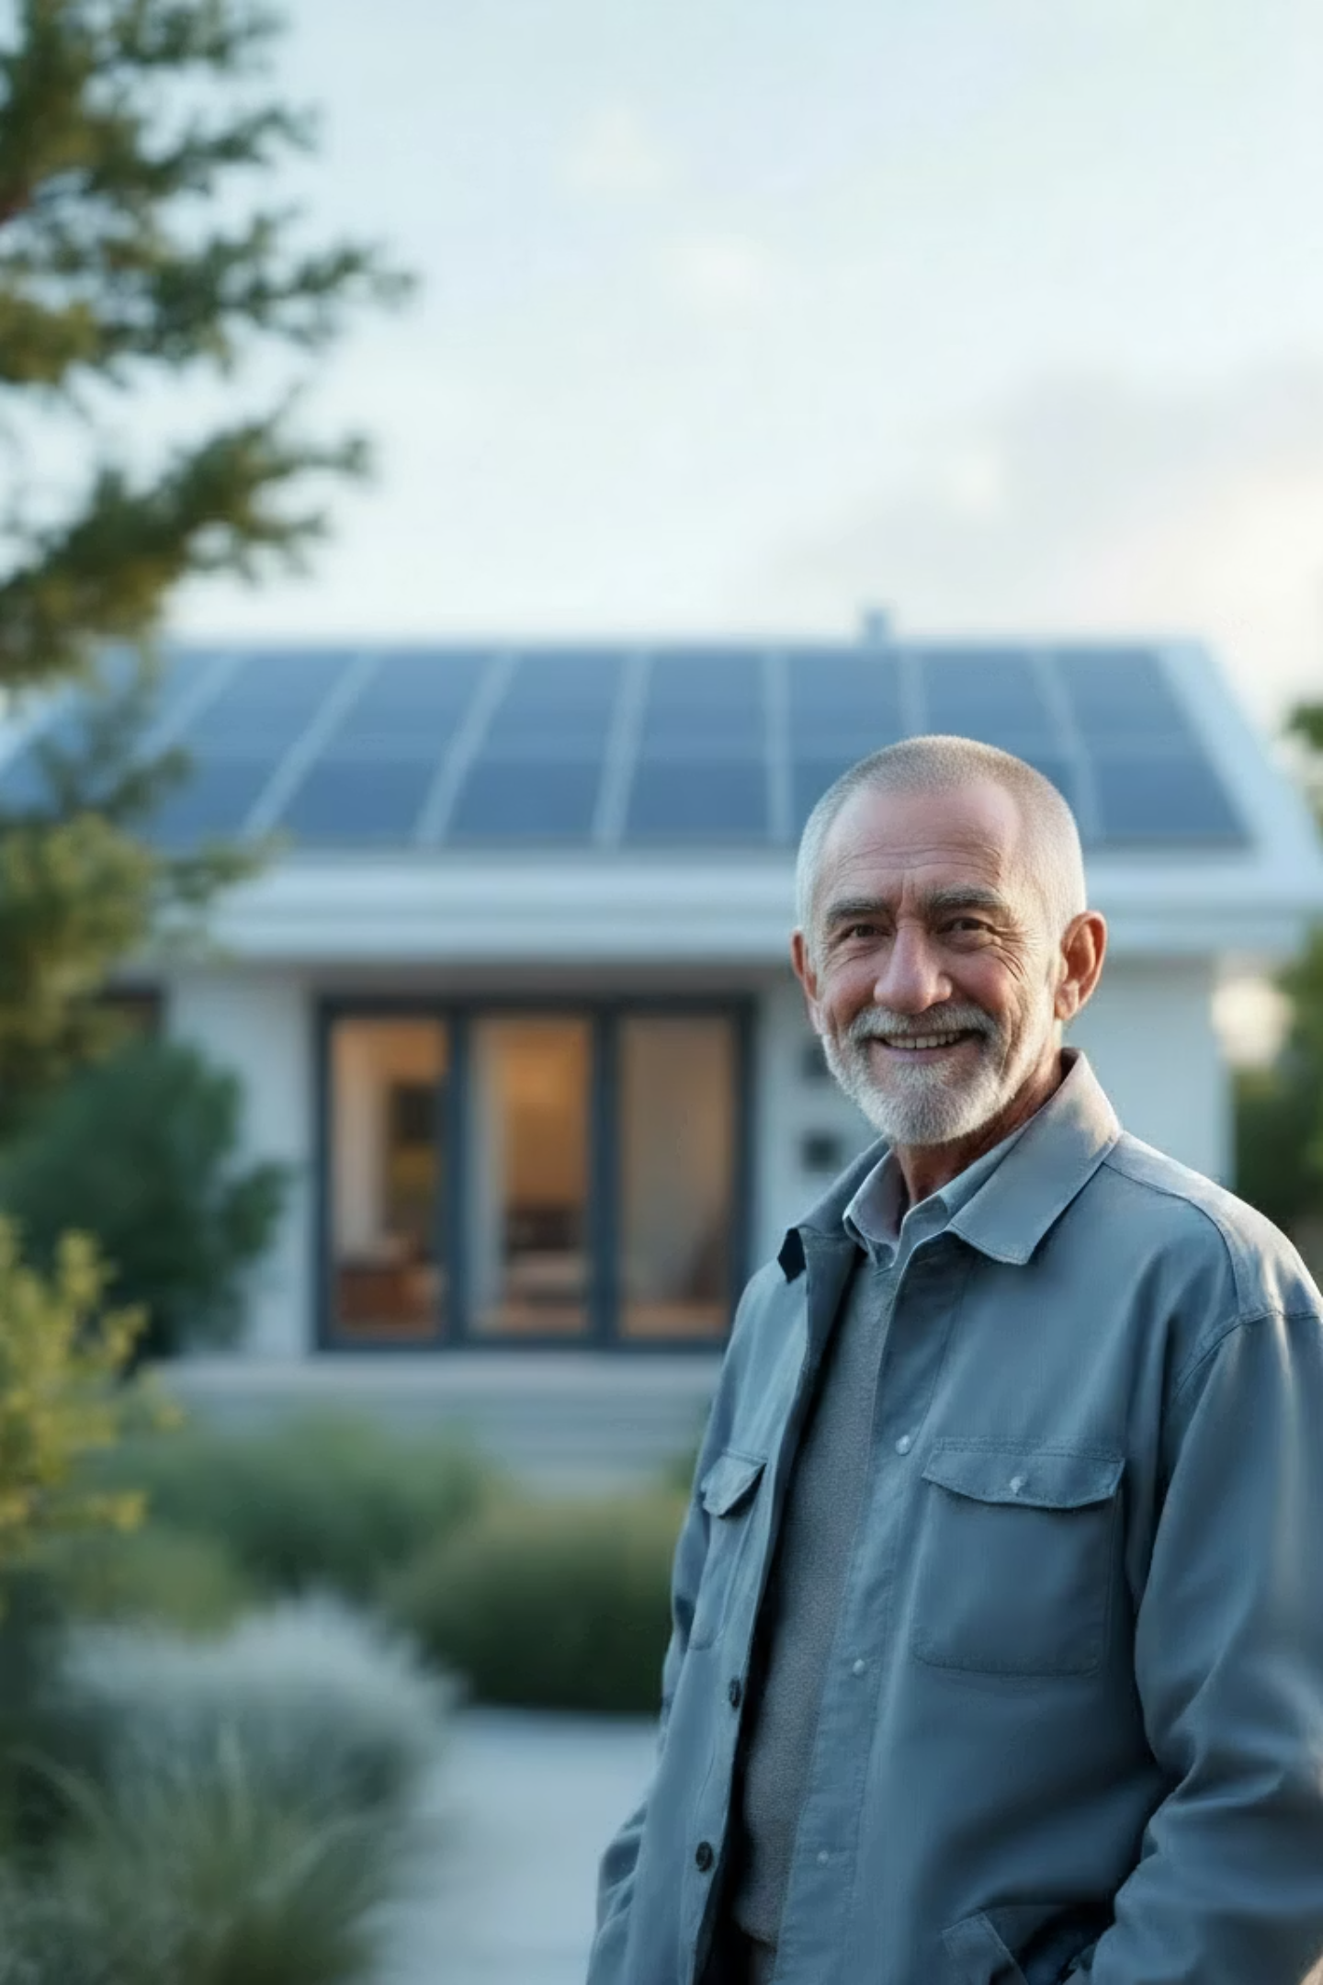
Project Context
Topic
Private smart home data provided by a friend → Real-world data
Data set: PV / energy / heating + weather data (03/24 – 09/25)
PV = Photovoltaic
Stakeholder - Jürgen
Retired engineer and tech enthusiast
Continuously optimizing his smart home system
Motivation
Help Jürgen understand:
Key metrics and influence factors on his (smart) home
Optimize his system for better financial returns

Slide 5
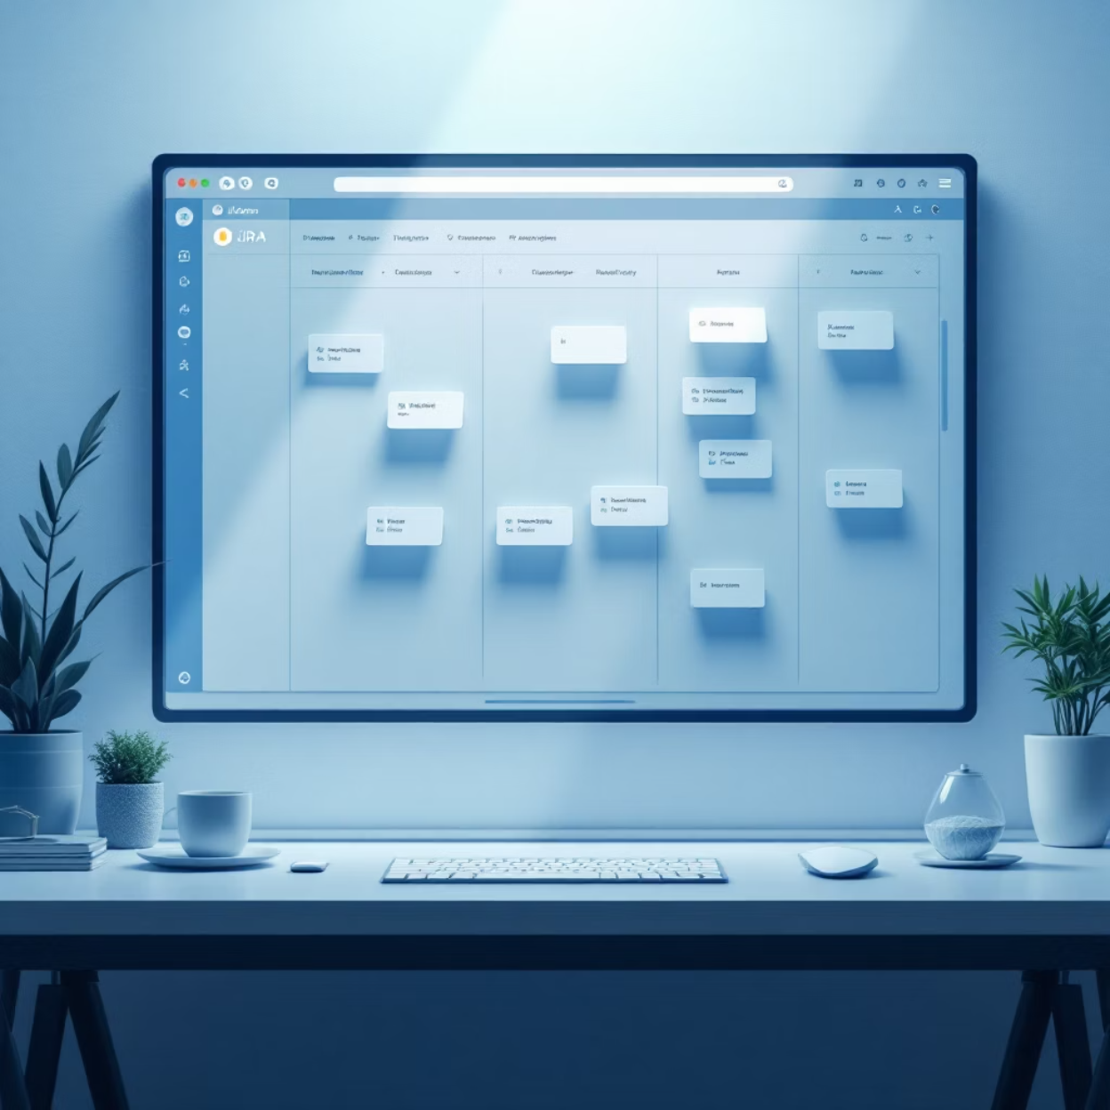


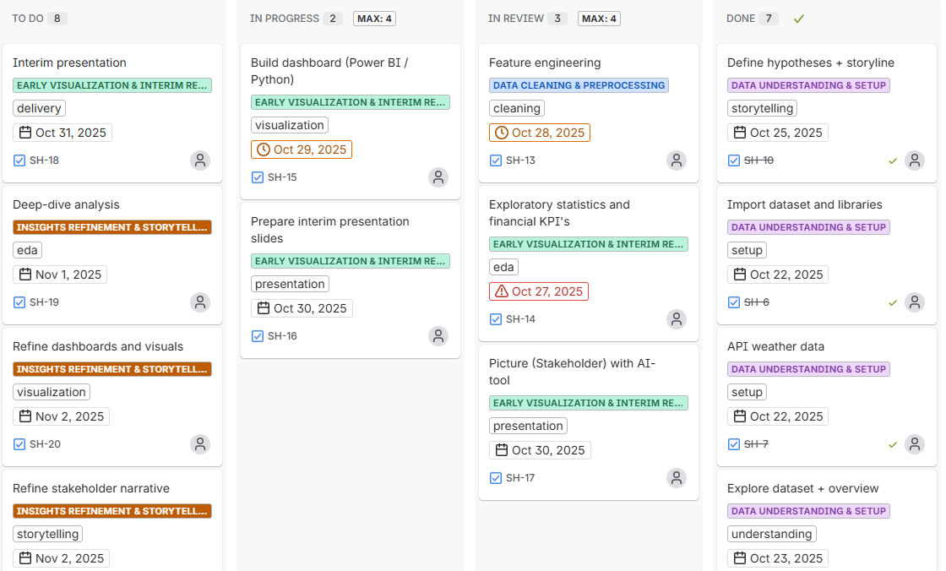
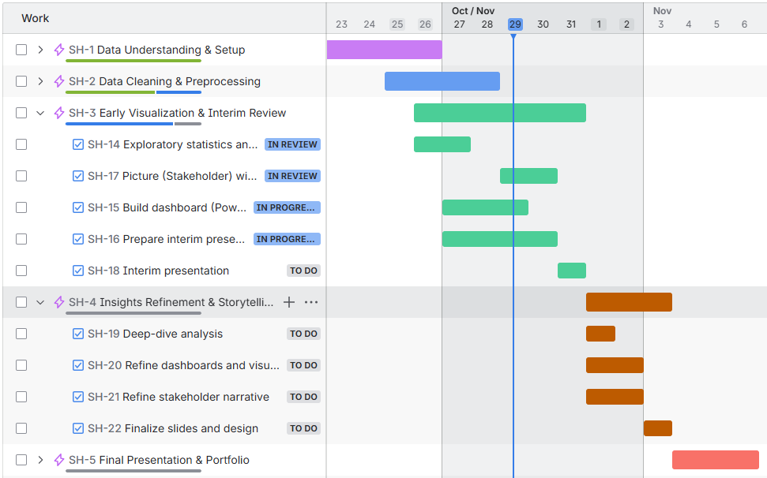




Planning & Technology Stack
Project Planning
Technology Stack
JIRA Kanban board for task tracking and workflow organization.
Python
Jira
Power BI
Streamlit
Gamma AI
PowerPoint

Slide 6



Data Sources & workflow
Data Sources
Energy data from PV system and consumption
9 CSV’s (one per sensor)
1.5 years – every 10 min → Daily aggregations
Power BI
Aggregation
per day
+ additional features
+ correlations
Weather data via OpenMeteo API
Streamlit
API
per day
Financial data from Jürgen's records

Slide 7
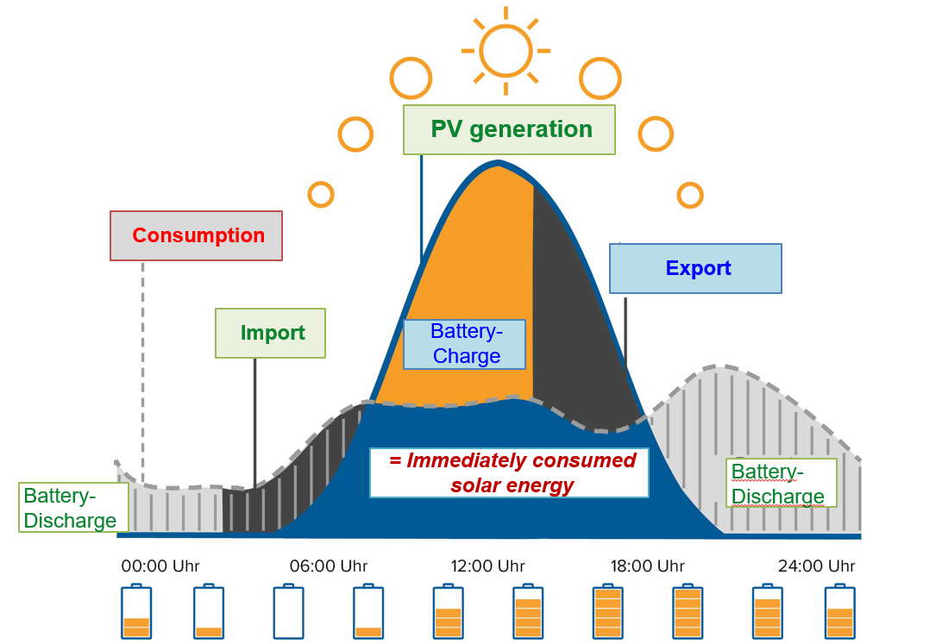
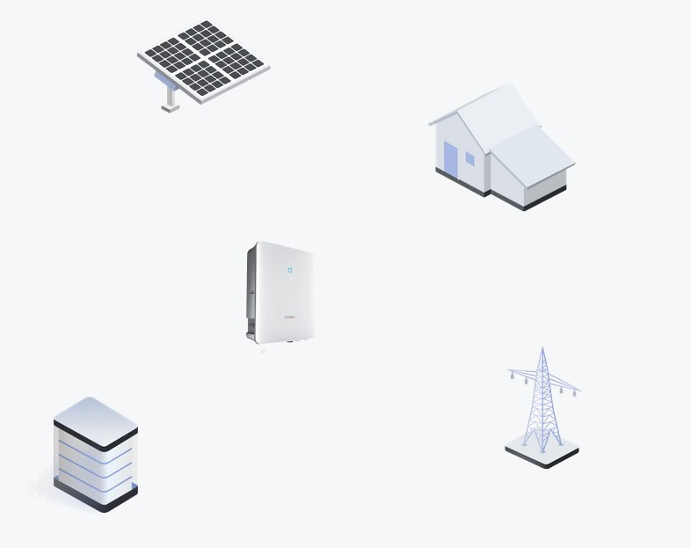
Energy Flow
PV-generation over the day
Energy Flow System
PV = Photovoltaic
PV Modul
PV Energy
House
Consumption
Inverter
Charge
Import
Discharge
Export
Power Grid
Battery
Consumption = PV + Import – Export – (Charge – Discharge)

Slide 8





Research Hypotheses
1. Heating Usage
Heating is used even when outdoor temperature exceeds 15°C
2. Solar energy – Influence factors on PV-generation
Season/month has greater impact on PV generation than weather conditions
3. Energy Independence
Self-sufficiency is only achieved in Q2 and Q3
4. Optimization Potential ⬄ Payback Period
Even under best conditions, the system amortization time can only be reduced by 1 year compared to current conditions

Slide 9


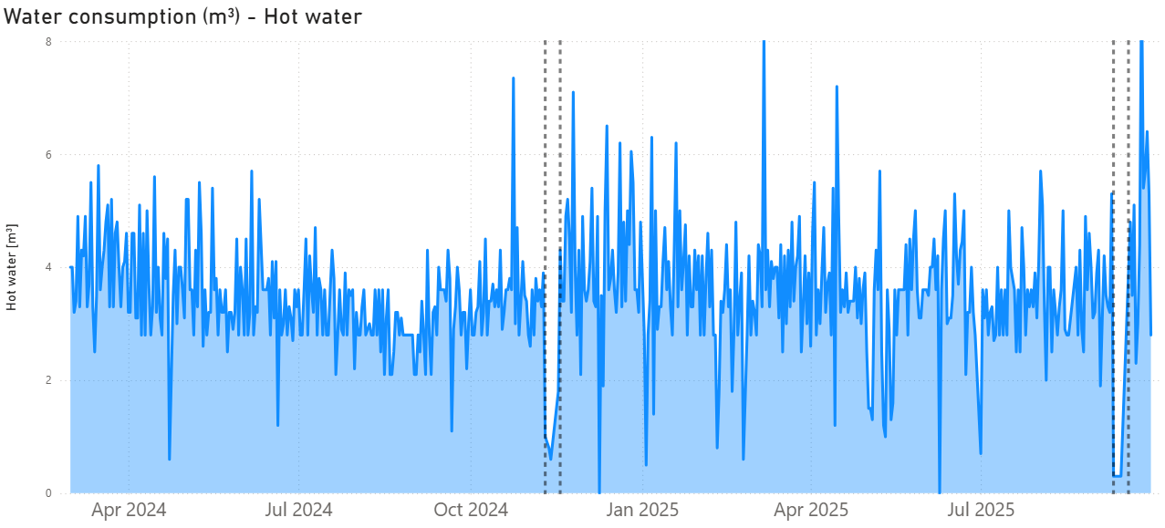


Hypothesis 1: Hot water & Heating usage
1. Hot water
Outliers of hot water usage:
Vacation time?
Sensor issue?
“Only cold showers”?
1.
2.
1
2
Data quality matters – "NaN“-values sometimes zero consumption ⬄ missing data

Slide 10
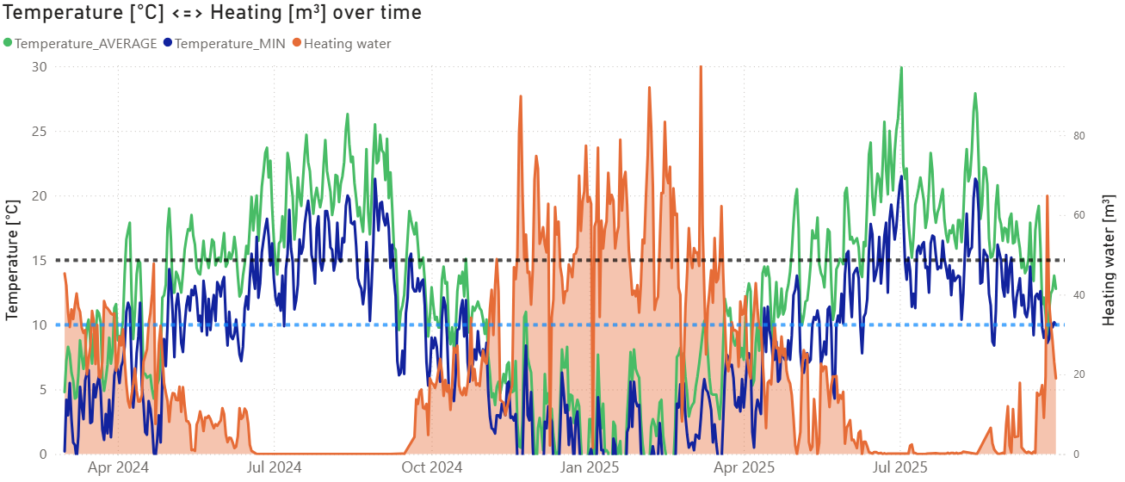

Hypothesis 1: Hot water & Heating usage
1. Hot water
2. Heating
Outliers of hot water usage:
Vacation time?
Sensor issue?
“Only cold showers”?
Heating used between October – June
Min-°C apparently more important than Mean-°C
Small saving potential for time frames with > 10°C_min
1. Heating Usage
Heating is used even when outdoor temperature exceeds 15°C
Data quality matters – "NaN“-values sometimes zero consumption ⬄ missing data
Heating occasionally used too long (when temperature > X °C), but only ~X% savings potential

Slide 11
Hypothesis 1: Hot water & Heating usage
1. Hot water
2. Heating
Outliers of hot water usage:
Vacation time?
Sensor issue?
“Only cold showers”?
Heating used between October – June
Min-°C apparently more important than Mean-°C:
Heating & Min-°C > 10°C: 111 days
Heating & Mean-°C > 15 °C: 91 days
Data quality matters – "NaN“-values sometimes zero consumption ⬄ missing data
Heating used too long (on 78 “warmer” days), but only ~5 % savings potential (107 m³ out of 2181 m³)

Slide 12
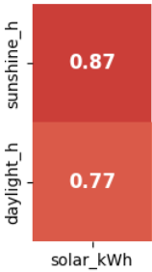
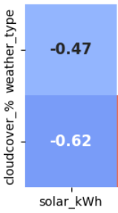
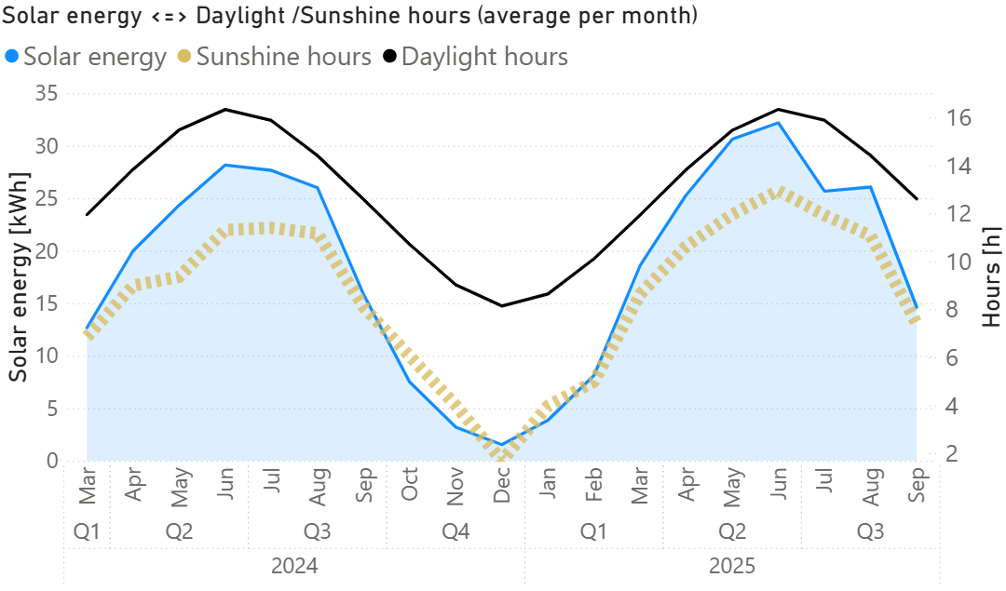
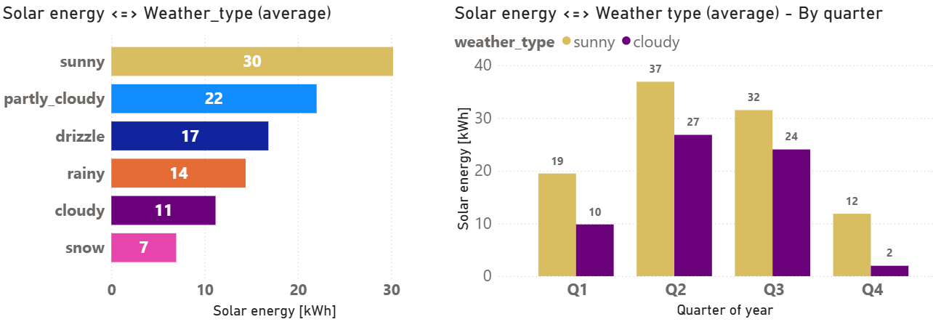
Hypothesis 2: Solar energy – Influence factors on PV-generation
PV = Photovoltaic
1. Season / sunshine hours
2. Weather conditions
Solar energy highly correlates:
to sunshine hours (0.87)
to daylight hours (0.77)
Huge correlation to weather type (-0.47) cloud coverage per day (-0.62)
Cloudy ⬄ sunny weather:
Q2 / Q3: up to -27 %
Q1 / Q4: up to -83 %
-27 %
2. Solar energy – Influence factors on PV-generation
-83 %
Season/month has greater impact on PV generation than weather conditions
Higher correlation of solar energy to seasonal effects (daylight…) than to weather type / cloud coverage
But: Weather conditions have severe influence too!

Slide 13
Hypothesis 2: Solar energy – Influence factors on PV-generation
PV = Photovoltaic
1. Season / sunshine hours
2. Weather conditions
Solar energy highly correlates:
to sunshine hours (0.87)
to daylight hours (0.77)
Huge correlation to weather type (-0.47) cloud coverage per day (-0.62)
Cloudy ⬄ sunny weather:
Q2 / Q3: up to -27 %
Q1 / Q4: up to -83 %
-27 %
-83 %
Higher correlation of solar energy to seasonal effects (daylight…) than to weather type / cloud coverage
But: Weather conditions have severe influence too!

Slide 14
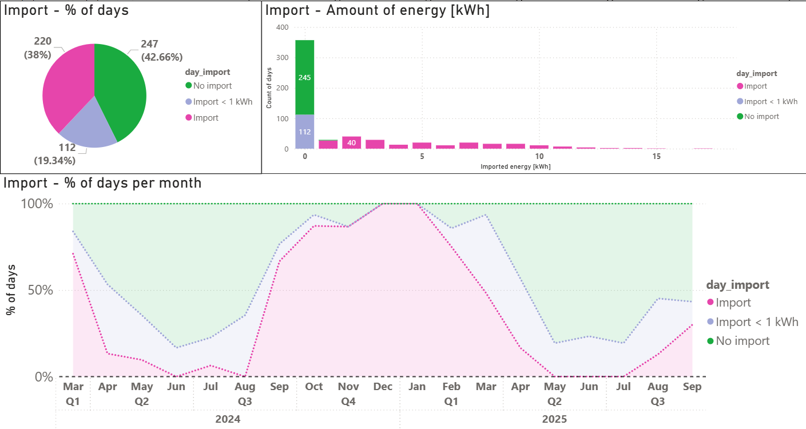
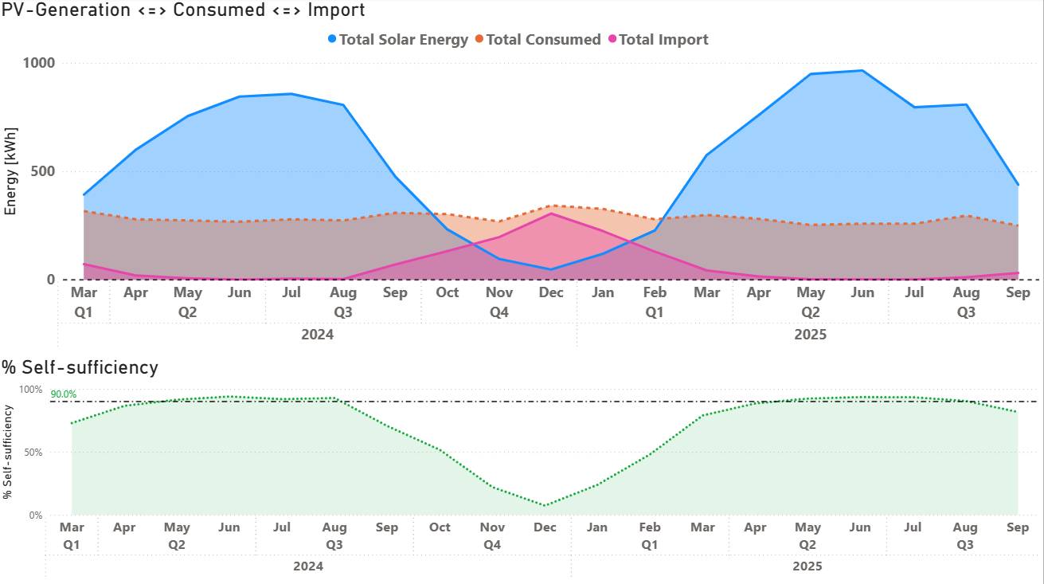

Hypothesis 3: Energy Independence
1. Energy flow + Self-sufficiency %
2. Energy import
Consumed energy is quite stable (~ 9.4 kWh/day)
Import > 50% from October – February
Self-sufficiency >90% from May – August
Days without imports even in November + February
63 % of days with < 1 kWh import
3. Energy Independence
Self-sufficiency is only achieved in Q2 and Q3
April-August: >80% of days have 0-1 kWh grid import (note: “NaN” could be “no import” or sensor issue)
Except Dec & Jan: Every month shows at least 4 days with 0-1 kWh import, even in Q1 and Q4
PV = Photovoltaic

Slide 15
Hypothesis 3: Energy Independence
1. Energy flow + Self-sufficiency %
2. Energy import
Consumed energy is quite stable (~ 9.4 kWh/day)
Import > 50% from October – February
Self-sufficiency >90% from May – August
Days without imports even in November + February
63 % of days with < 1 kWh import
Except Dec & Jan: Every month shows at least 4 days with 0-1 kWh import, even in Q1 and Q4
(note: “NaN” could be “no import” or sensor issue)

Slide 16
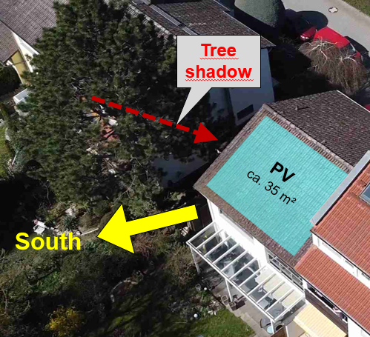
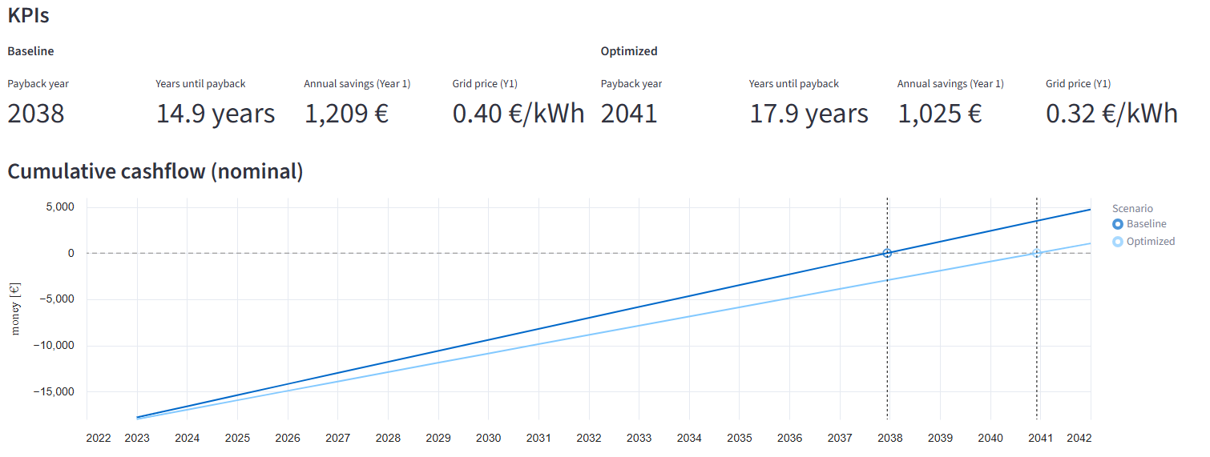
Hypothesis 4: Optimization Potential ⬄ Payback period
1. Hardware
2. Yearly energy costs (Import) ⬄ Feed-in tariff (Export)
a.) More PV-generation:
Solar panels
Shadow from tree
X
X
a.) Feed-in tariff : Fixed for 20 years (0.082 € per kWh)
b.) Import costs:
Optimization potential: ~0.32 €/ kWh instead of 0.40 €/ kWh
BUT: fewer yearly costs → longer amortization time
X
X
b.) Battery:
Current battery capacity = 9.6 kWh
Consumption per day (avg) = 9.4 kWh ➔ Charged battery lasts for ~ 1 day
c.) Electric Vehicle :
Potential “big battery” in the future
4. Optimization Potential ⬄ Payback Period
Even under best conditions, the system amortization time can only be reduced by 1 year compared to current conditions
~ 5000 – 6000 € invest!
LINK to Streamlit-App
No hardware optimizations (except electric vehicle)
Cheaper contract results in fewer yearly costs (- 90 €), but higher amortization time (> 3 years)

Slide 17
Hypothesis 4: Optimization Potential ⬄ Payback period
1. Hardware
2. Yearly energy costs (Import) ⬄ Feed-in tariff (Export)
a.) More PV-generation:
Solar panels
Shadow from tree
X
X
a.) Feed-in tariff : Fixed for 20 years (0.082 € per kWh)
b.) Import costs:
Optimization potential: ~0.32 €/ kWh instead of 0.40 €/ kWh
BUT: fewer yearly costs → longer amortization time
X
X
b.) Battery:
Current battery capacity = 9.6 kWh
Consumption per day (avg) = 9.4 kWh ➔ Charged battery lasts for ~ 1 day
c.) Electric Vehicle :
Potential “big battery” in the future
~ 5000 – 6000 € invest!
LINK to Streamlit-App
No hardware optimizations (except electric vehicle)
Cheaper contract results in fewer yearly costs (- 90 €), but higher amortization time (> 3 years)

Slide 18
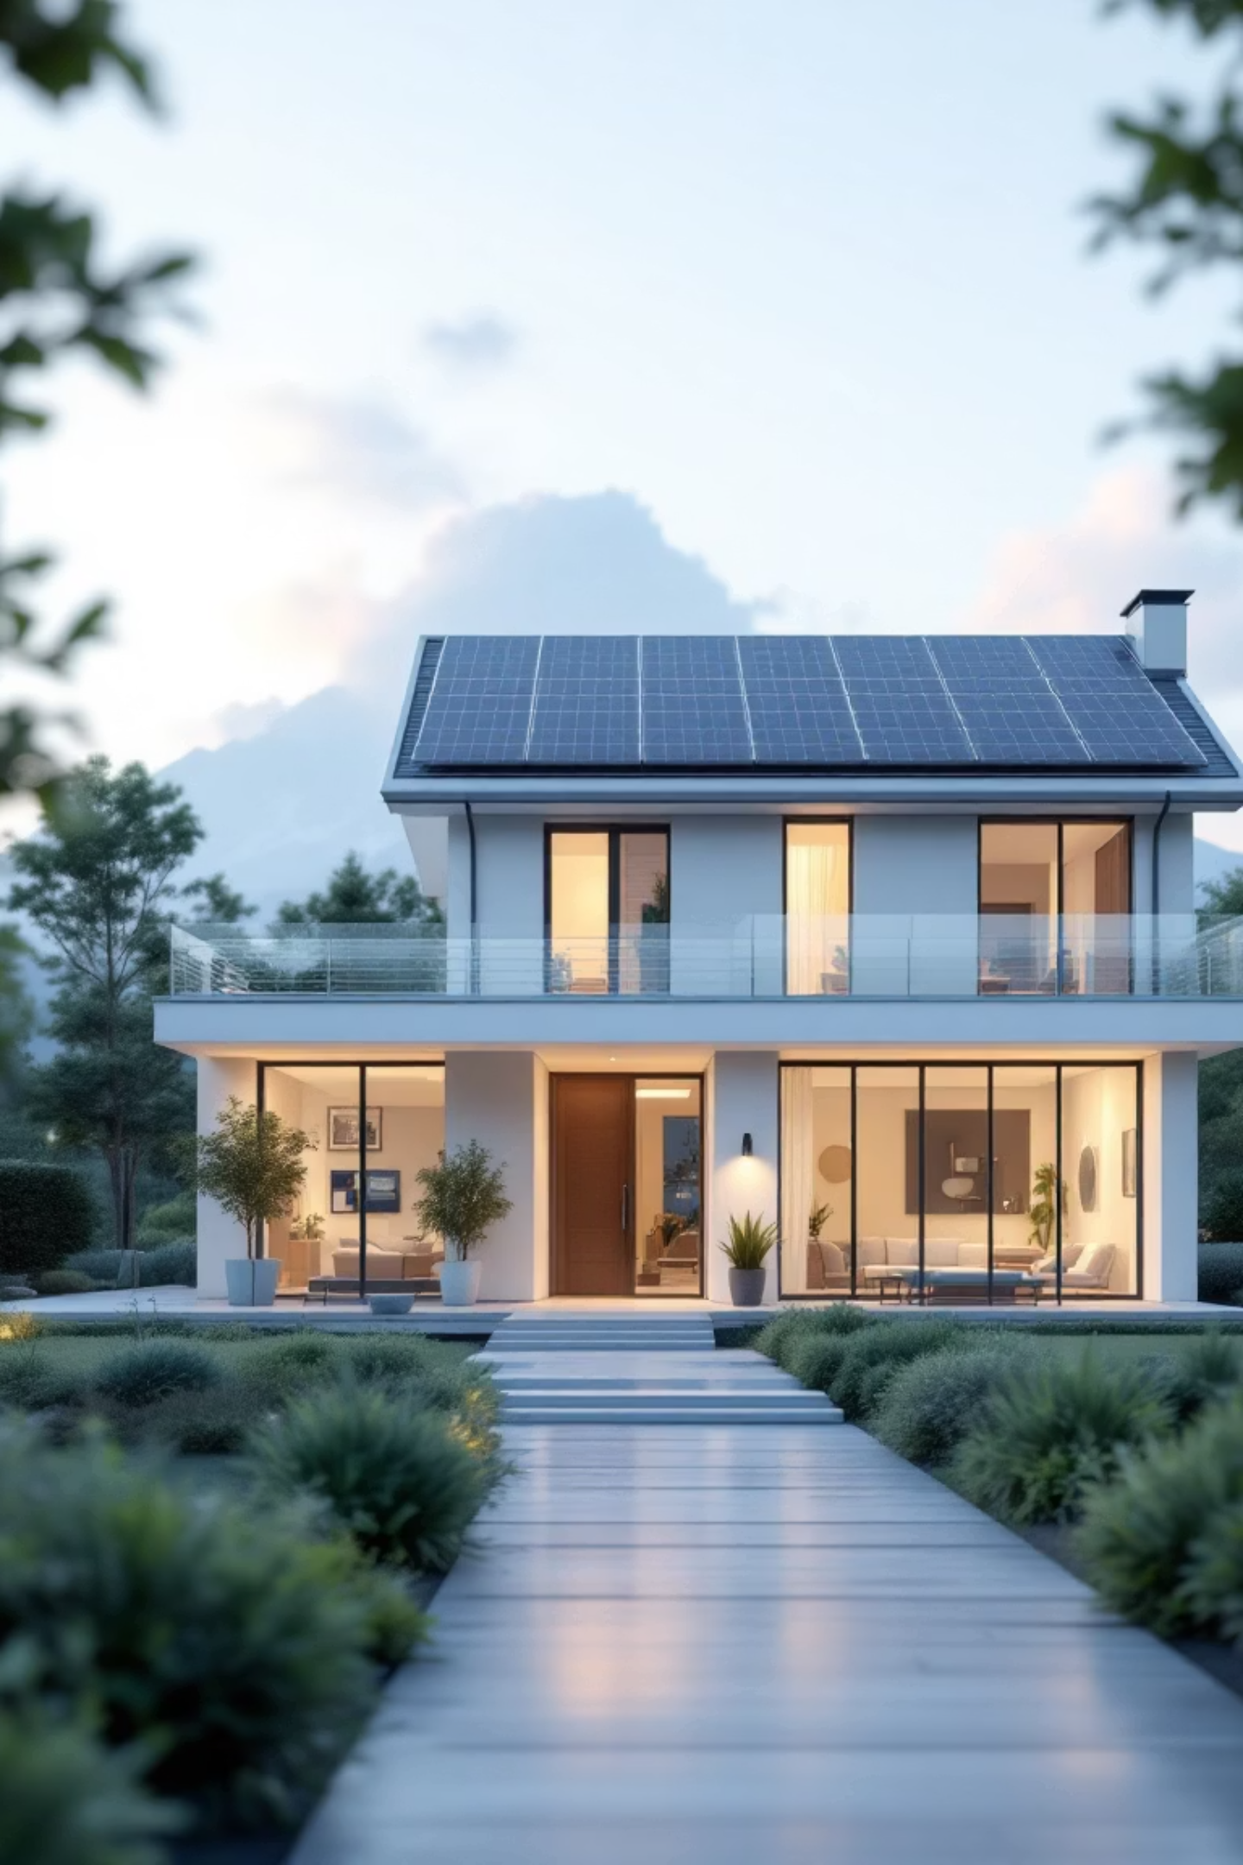


Summary & Recommendations
Heating optimization offers limited savings
Seasonal > weather influences on solar energy
Self-sufficiency achievable in all seasons
Amortization time highly driven by import costs
Main findings
Monitor heating patterns during spring / fall
Implement data validation checks [NaN values]
Evaluate electricity contracts regularly to reduce yearly costs for import
Recommendations to Jürgen

Slide 19



Thank you
for your attention!
GitHub - Repository
Interested in discussing data analytics, or career opportunities in BI?
Power-BI Dashboard
LinkedIn
Connect with me on
LinkedIn
Streamlit -App

